Slide 1
Maths Quiz
Activities and Intents
JavaDocs

Slide 2
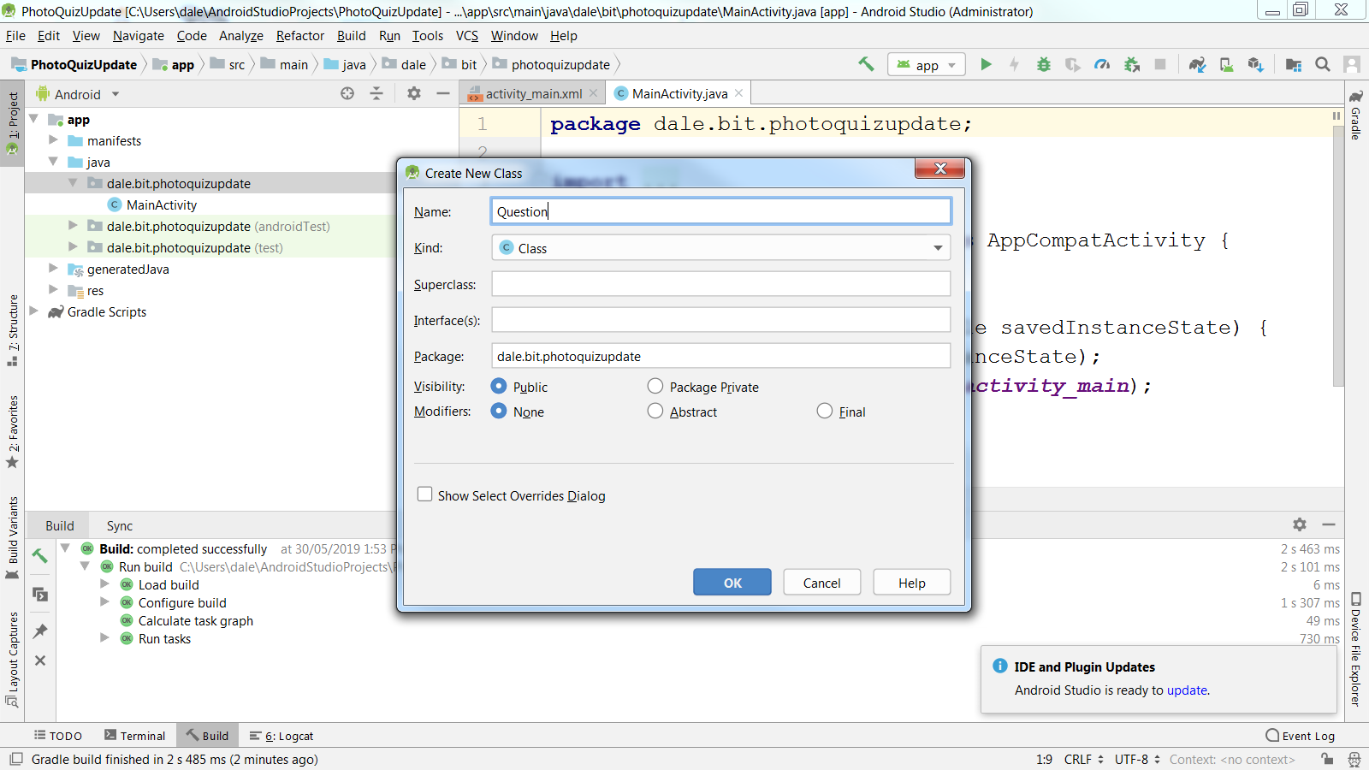
Create a Java Question class

Slide 3
Convert an editText value to an integer
EditText etAnswer = (EditText) findViewById(R.id.editText);
int answer = Integer.parseInt(etAnswer.getText().toString());

Slide 4
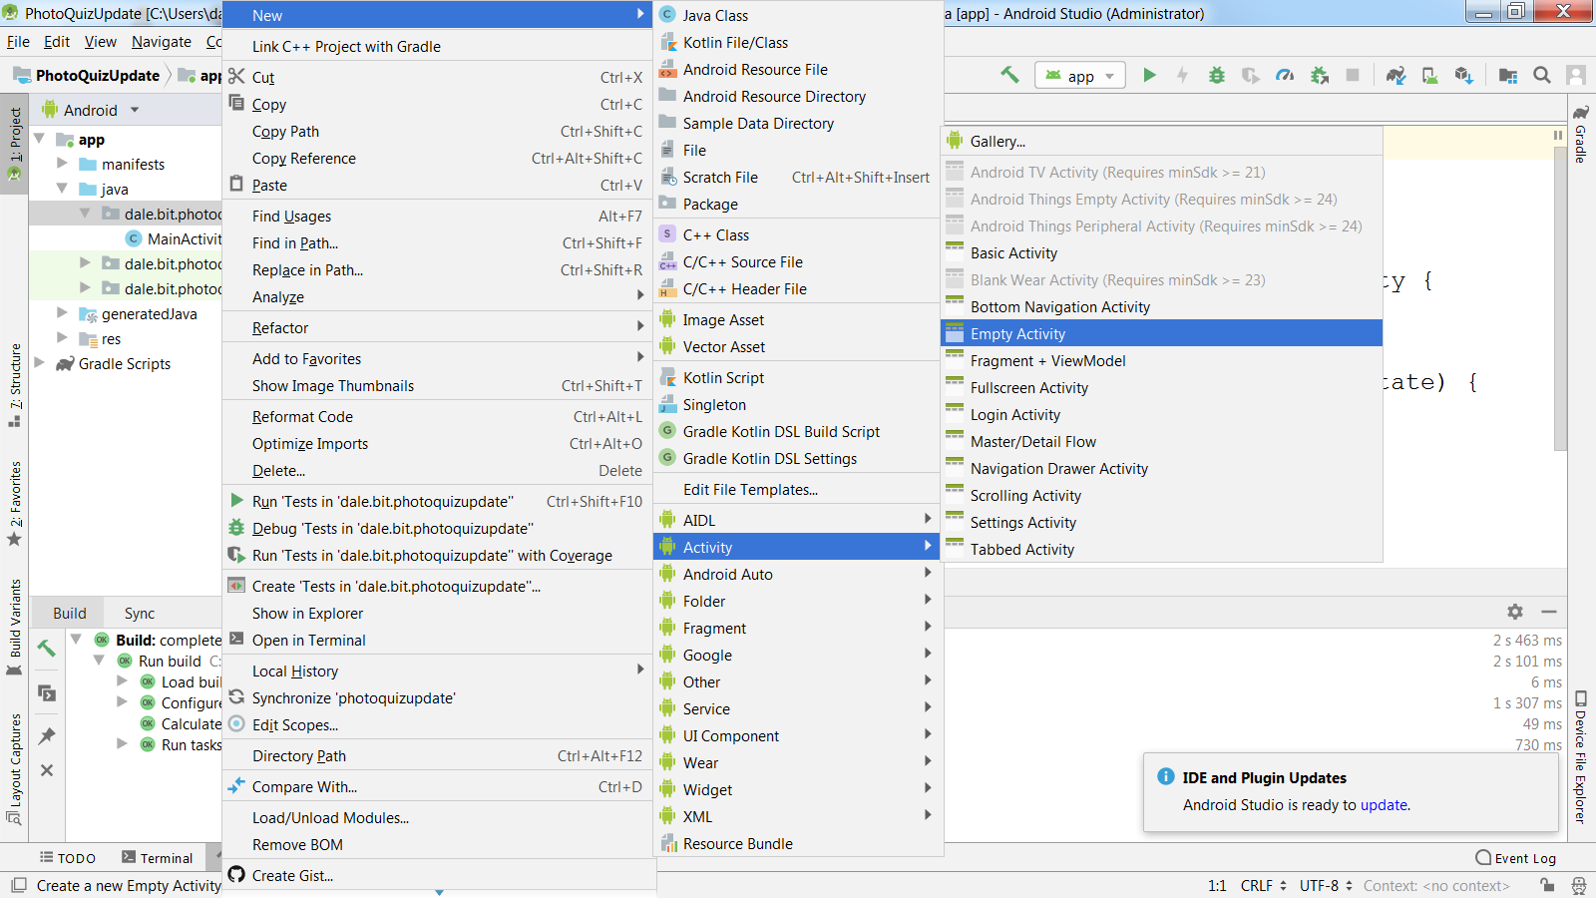
New Activity

Slide 5
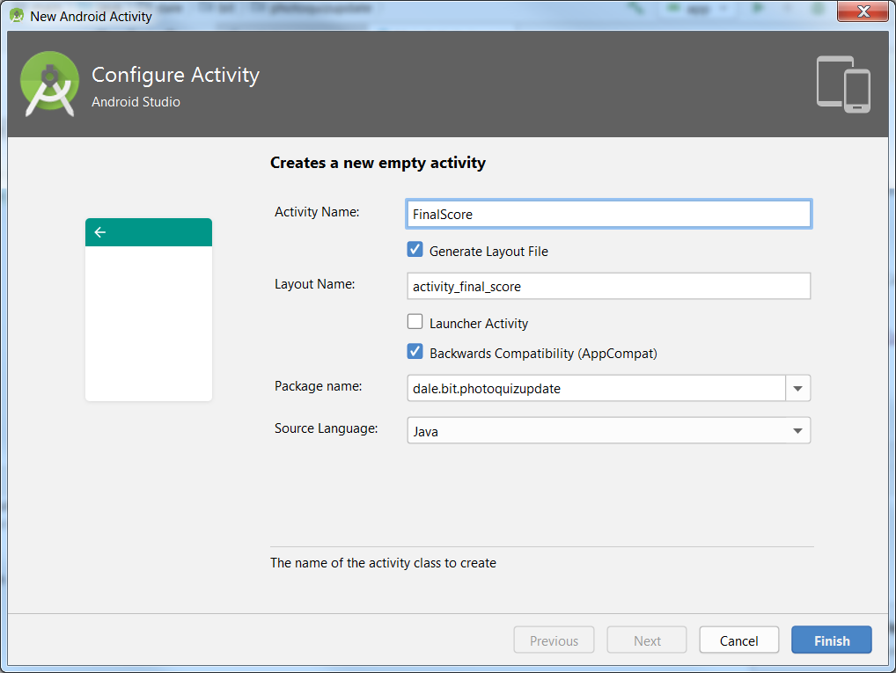
This is the title bar of the final screen: call it FinalScore or Results

Slide 6
Activity Navigation
Use explicit Intents to navigate between multiple Activities within a single application.

Slide 7
Activity Navigation
Development process:
Write the Java code and XML layouts for all your Activities (one per screen).
At the point in the code of Activity X where you wish to programmatically pass control to Activity Y:
Create the necessary intent with:
new Intent(currentActivityInstance, targetActivityClass)
Call the system method startActivity, passing the intent.
Notes:
Write the code and layouts for all your activities.
At the point in the code of Activity X where you wish to programmatically pass control to Activity Y:
Create the necessary intent with new Intent(currentActivityInstance, targetActivityClass)
Call the system method startActivity, passing that intent.

Slide 8

Explicit Intent
Inside MainActivity
Making a new intent
Passing data
Notes:
We will be using the explicit form today to move between multiple activities (screens) in a single app.
We will look at the syntax of that in detail in just a minute.
In the implicit constructor action is one of a set of constants defined in the Intent class, and data depends on what action you are calling.
You create the appropriate intent instance, and pass it to (in most cases) the startActivity method.
For example, this button click handler, will, when the button is clicked, open the phone's browser and go to the indicated web site.
There are a LARGE number of actions, each with particular data requirements. We won't cover them all in detail, but you will have relevant readings.
However, we will look first at explicit intents, which allow us to move between Activities within a single application -- arguably the most important use of the facility.

Slide 9
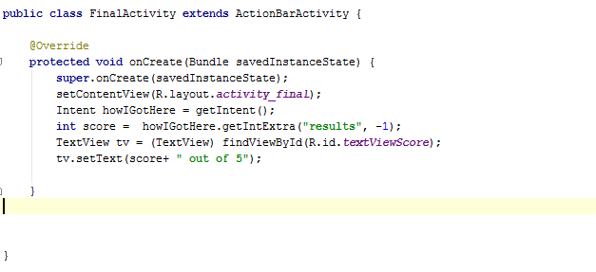
Inside the Second Activity
Get data back with getIntExtra
tv.setText(Integer.toString(score));
Notes:
You get back a -1 if no value is found

Slide 10
Registering Activities
For Activities within a single app
Each Activity must be added to AndroidManifest.xml
You should provide navigation so the user can return to the logical parent screen in the app hierarchy by tapping the Up button in the title bar.
<activity android:name=".FinalScore" android:parentActivityName=".MainActivity">
</activity>
Notes:
This discussion applies only to local registration with your application, not the system-wide registration we mentioned earlier for Services and Content Providers
All activities must be “registered”
This simply means that they must be entered as XML elements in the appropriate configuration file.
If you use the create Wizard, this is done for you automatically (it’s a good idea to check).
If you create your own class, just do it by hand.
Let’s look briefly at the manifest now.
We are talking about this file here…

Slide 11
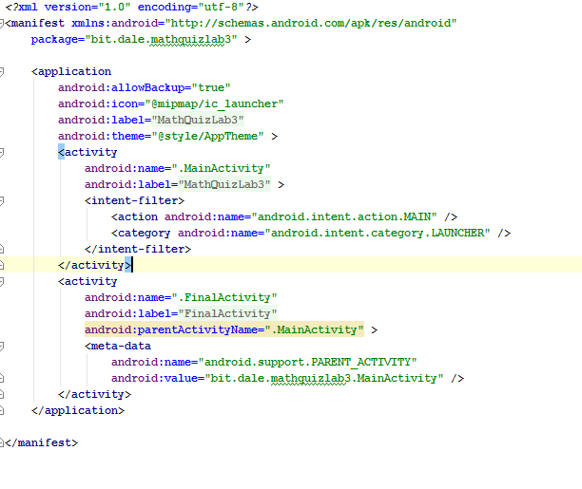
AndroidManifest.xml

Slide 12
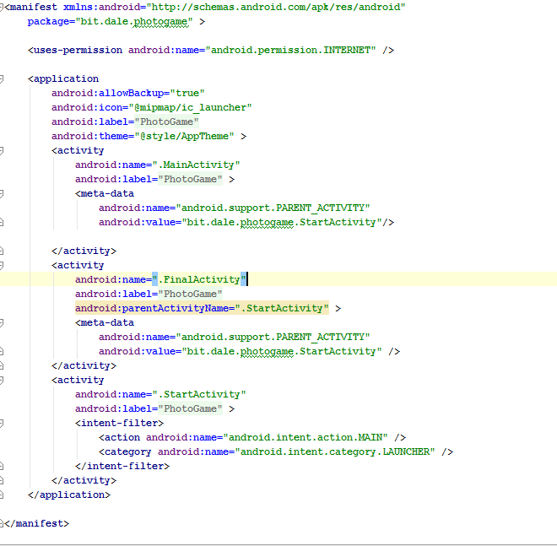
Notes:
Different program
3 activities who starts?

Slide 13
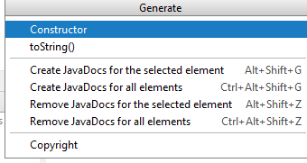
Java Docs
Manual approach:
Type /** and press enter in the appropriate place above a method.
For an plugin to give you skeletons like eclipse
File|Settings|Plugins
- search for JavaDoc in repositories
Once installed right click in your class code and select generate

Slide 14
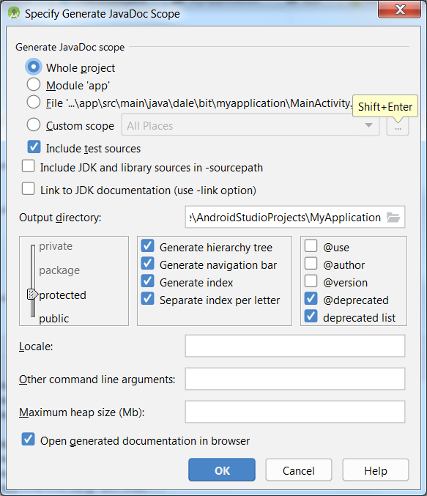
Tools| Generate Java Docs

Slide 15
Read
https://developer.android.com/training/index.html

